Slide 1
Day 2. For Loops, While Loops, Shift Register, Data Types
Prepared by:
Alexander De Los Reyes
03 April 2019

Slide 2
For loops & While loops
Loops enable programmers to execute a sequence of instructions repeatedly with a condition specifying when the loop will stop.
A loop enables you to write a very simple statement to produce a significantly greater result simply by repetition.
Each pass through the loop is called an iteration.
LabVIEW uses For and While Loops to control repetitive operations within a VI.

Slide 3
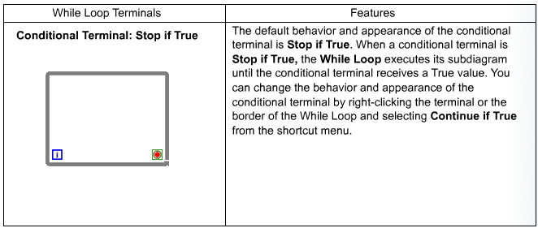
For loops & While loops
A While Loop executes a subdiagram until a condition occurs.
It acts similar to a Do Loop or a Repeat-Until Loop in text-based programming.
To place a While Loop, select While Loop from the Structures subpalette.
Next, use the cursor to drag a selection rectangle around the section of the block diagram you want to repeat.

Slide 4
For loops & While loops
A For Loop executes a subdiagram a set number of times.
The For Loop is located on the Structures subpalette.
Placing a For Loop is similar to placing a While Loop.
To replace a While Loop with a For Loop on the block diagram, right-click the border of the While Loop and select Replace with For Loop from the shortcut menu.

Slide 5
LabVIEW Example
Open For Loop
Open While Loop

Slide 6
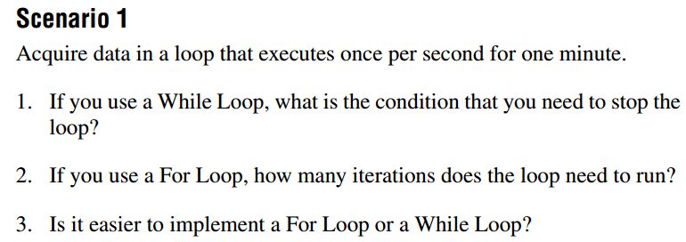
QUIZ. For Loops vs While loops

Slide 7
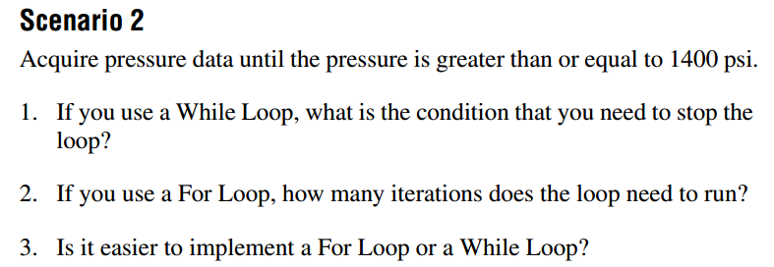
QUIZ. For Loops vs While loops

Slide 8
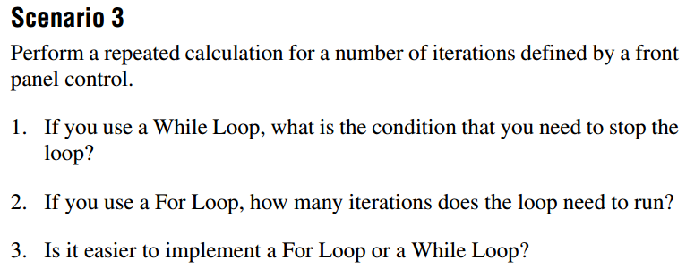
QUIZ. For Loops vs While loops

Slide 9
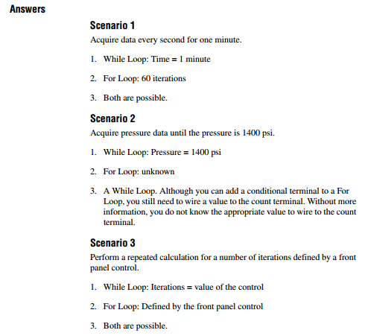
QUIZ. For Loops vs While loops

Slide 10
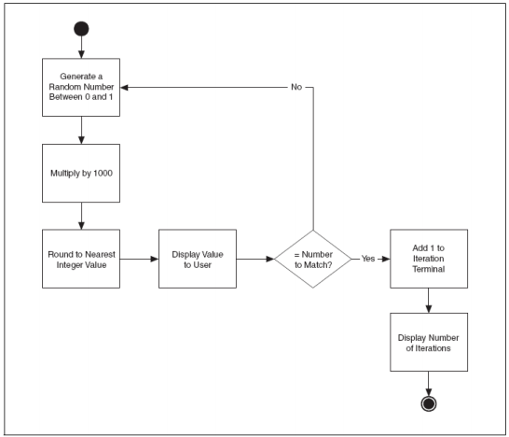
Example. While Loop

Slide 11
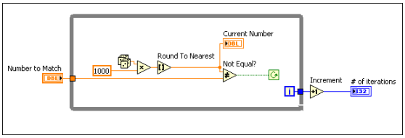
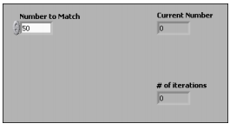
Example. While Loop

Slide 12
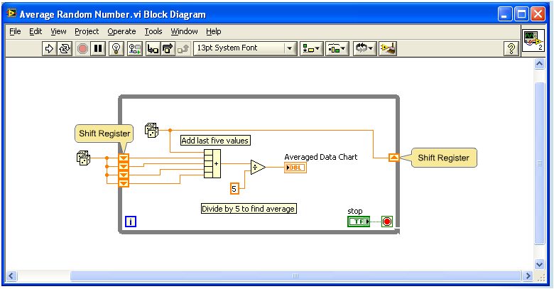
Shift Registers
When programming with loops, you may need to access data from previous iterations of the loop.
For example, if you are acquiring one unit of data in each iteration of a loop and need to average every five units of data, you need to access the data from previous iterations of the loop.
This can be done using shift registers that transfer values from one loop iteration to the next.
Shift registers are similar to static variables in text-based programming languages.

Slide 13
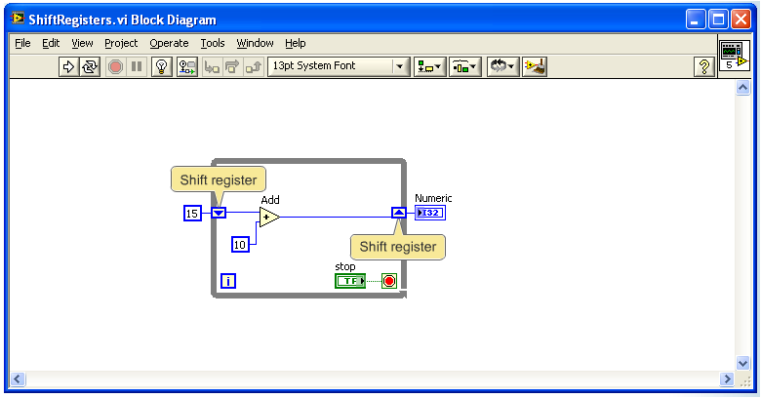
Shift Registers
Shift registers are used to pass values from previous iterations through the loop to the next iteration.
They appear as a pair of terminals directly opposite each other on the vertical sides of the loop border.
The right-side terminal contains an up arrow and stores data on the completion of an iteration.
LabVIEW transfers the data connected to the right-side of the register to the next iteration.
After the loop executes, the terminal on the right-side returns the last value stored in the shift register.

Slide 14
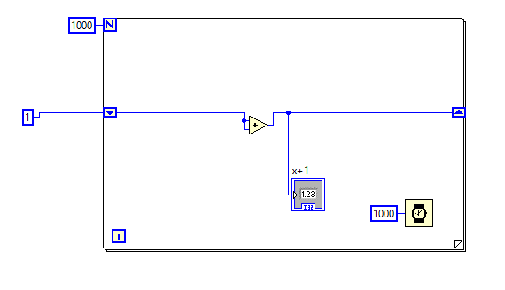
Shift Registers. Example

Slide 15
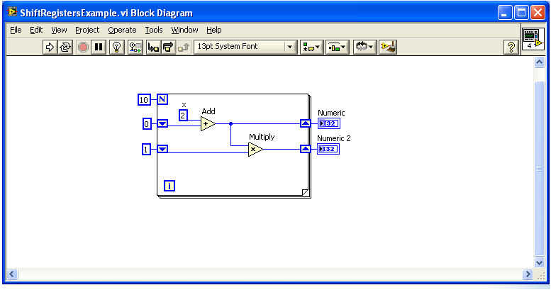
More shift registers

Slide 16
Mathscript

Slide 17
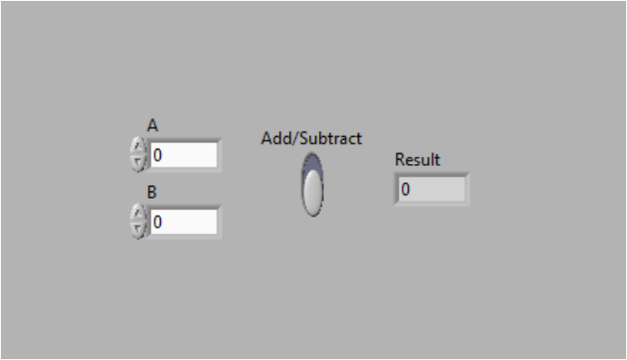
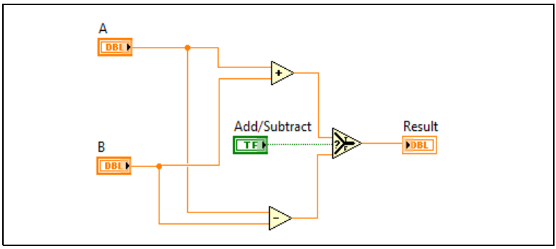
Example. Writing LV Programs

Slide 18
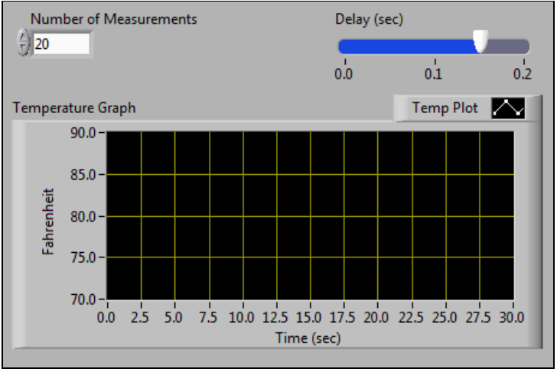
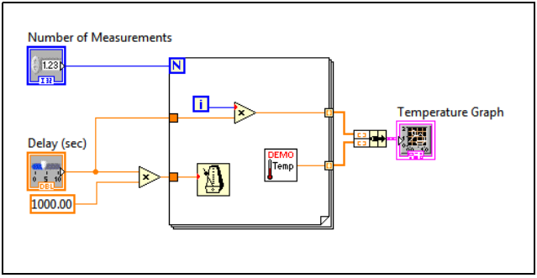
Example. Selecting a tool

Slide 19
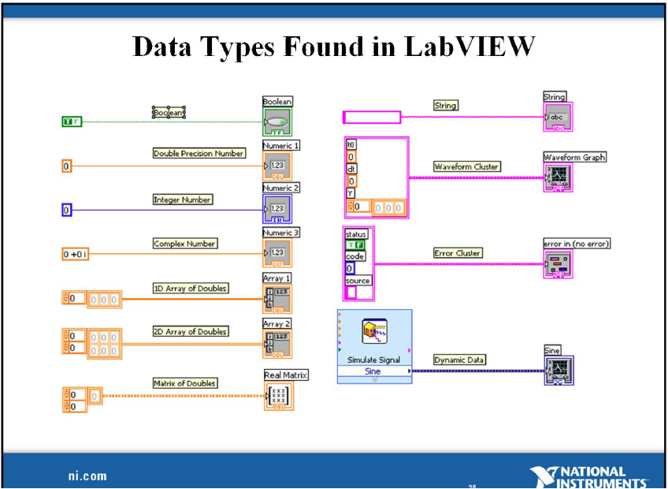
Recall: Data Types

Slide 20
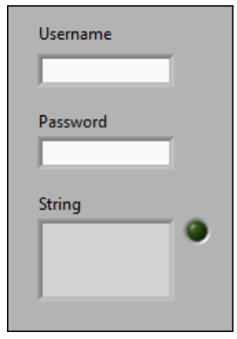
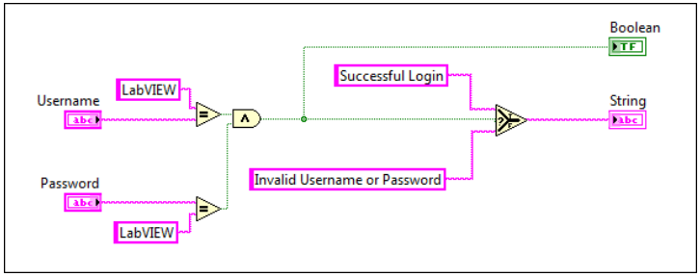
Example. More LV Data Types

Slide 21
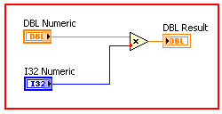
More on data types
LabVIEW can represent numeric data types as signed or unsigned integers, floating-point numeric values, or complex numeric values.
Normally, when different representation types are wired to the inputs of a function, the function returns an output in the larger or wider format.
LabVIEW chooses the representation that uses more bits.
If the number of bits are the same, LabVIEW chooses unsigned integer values over signed values.
Notes:
In the block diagram, a DBL numeric and an I32 numeric control are wired to a multply function, resulting in a final output of a DBL numeric indicator. The I32 numeric control, a 32-bit signed integer, is a coerced because it use fewer bits than the DBL numeric control, a double precision, floating point numeric value. The lower input of the multiply function shows a red dot called a coercion dot indicating numeric coercion

Slide 22
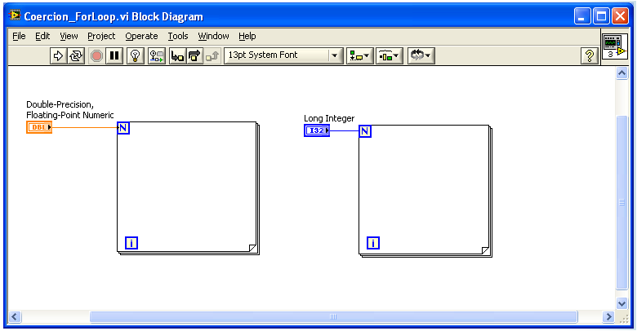
More on data types
Notes:
In the block diagram, a DBL numeric and an I32 numeric control are wired to a multply function, resulting in a final output of a DBL numeric indicator. The I32 numeric control, a 32-bit signed integer, is a coerced because it use fewer bits than the DBL numeric control, a double precision, floating point numeric value. The lower input of the multiply function shows a red dot called a coercion dot indicating numeric coercion

Slide 23
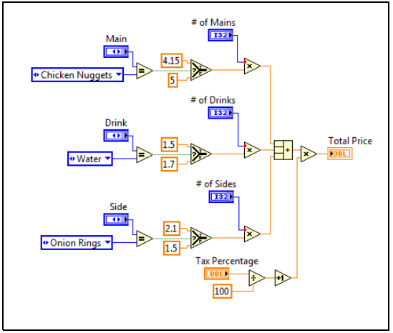
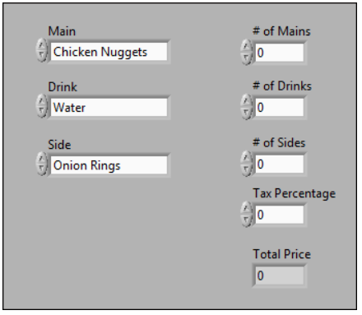
Example. Understanding Data Types

Slide 24
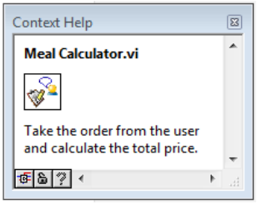
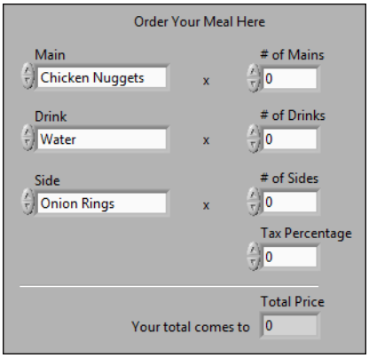
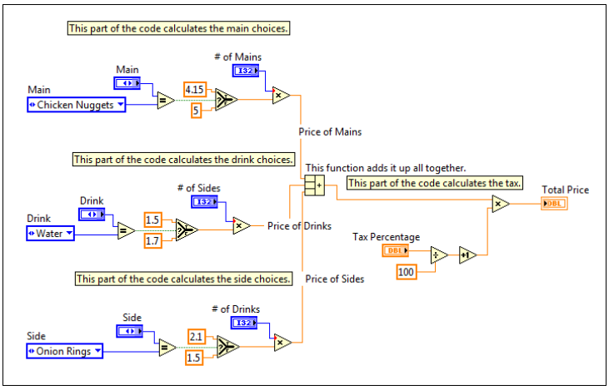
Example. Documenting a code

Slide 25
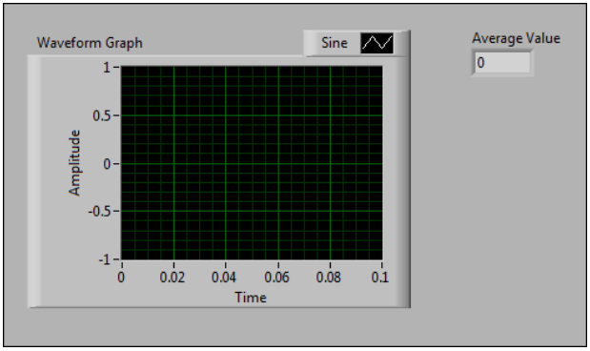
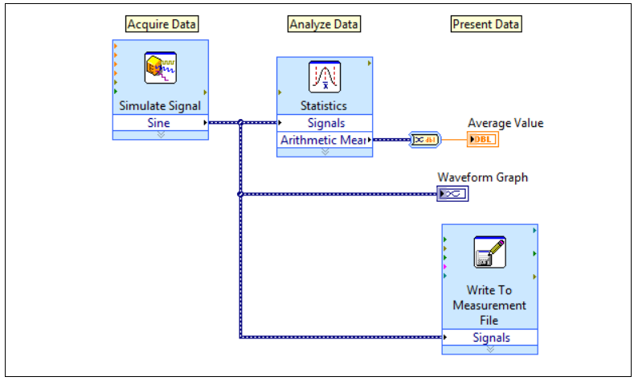
Group Exercise. Simple AAP VI

